Slide 1
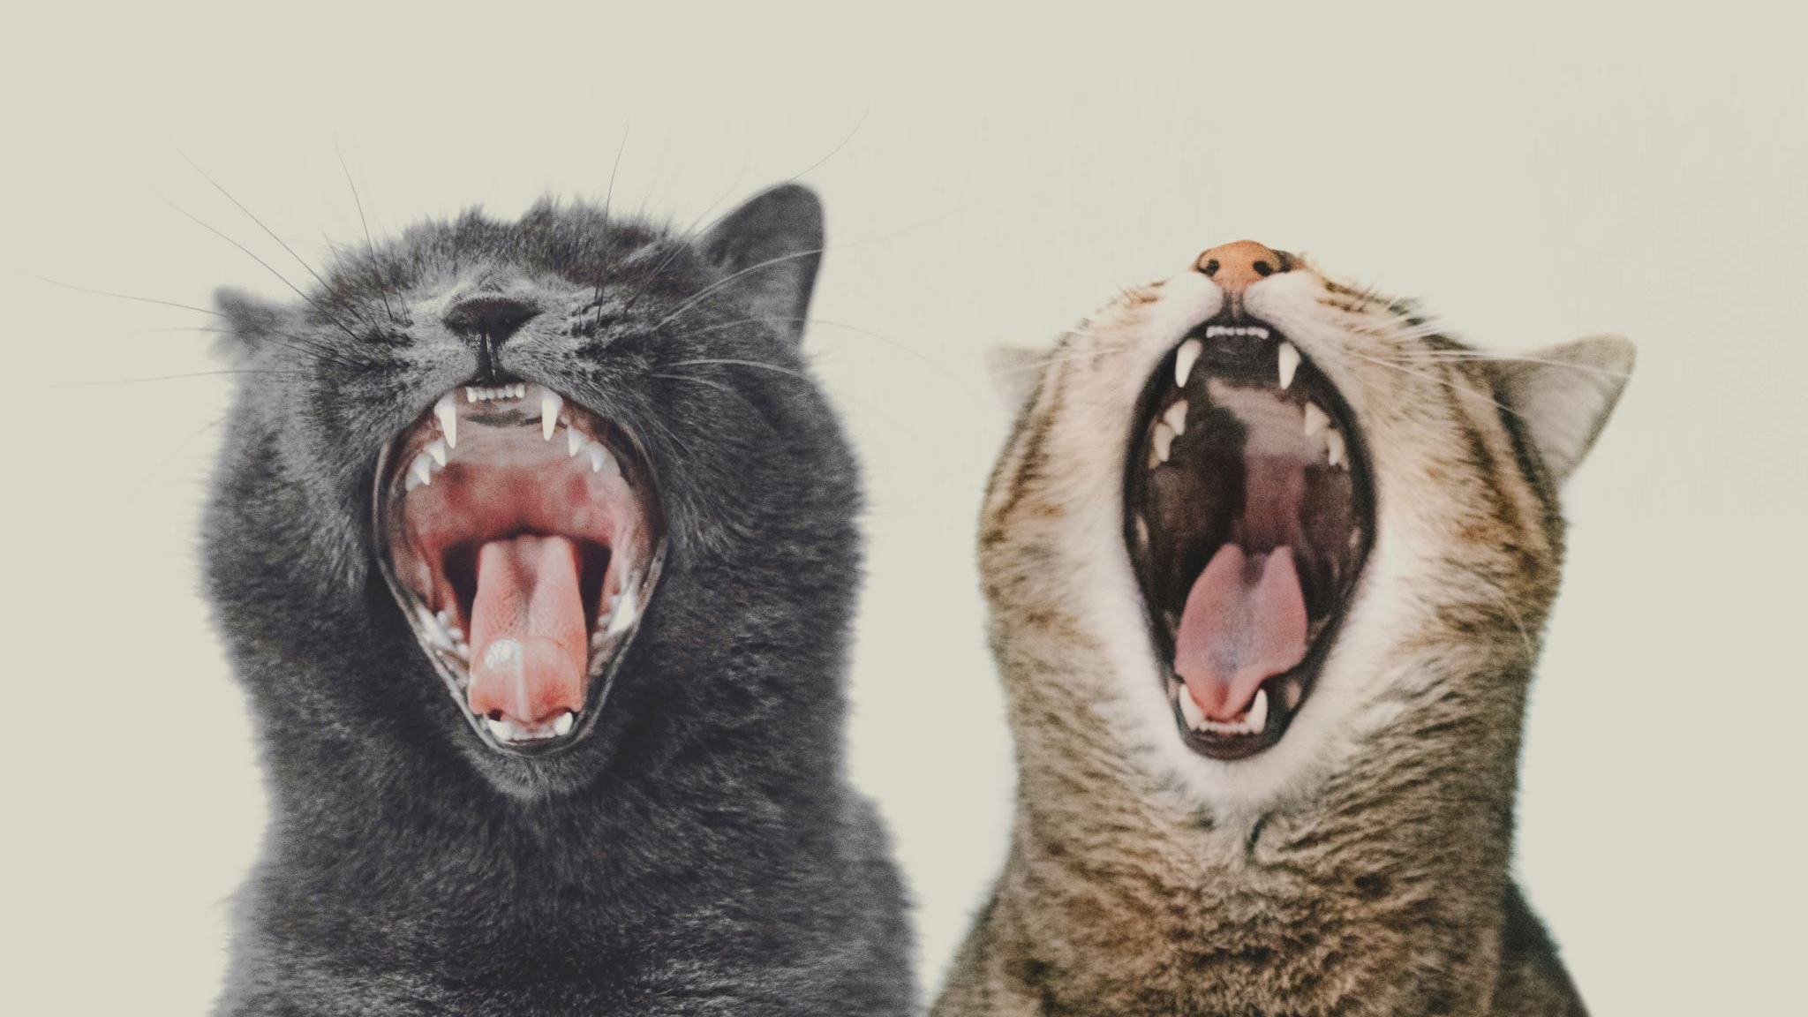
3 reasons why I like Cats
By Sebastian Webster

Slide 2

Agenda
Reason 1 why I like cats – They are cute, fluffy, and make you happy
Reason 2 why I like cats – Long lifespan
Reason 3 why I like cats - Independence
Conclusion

Slide 3
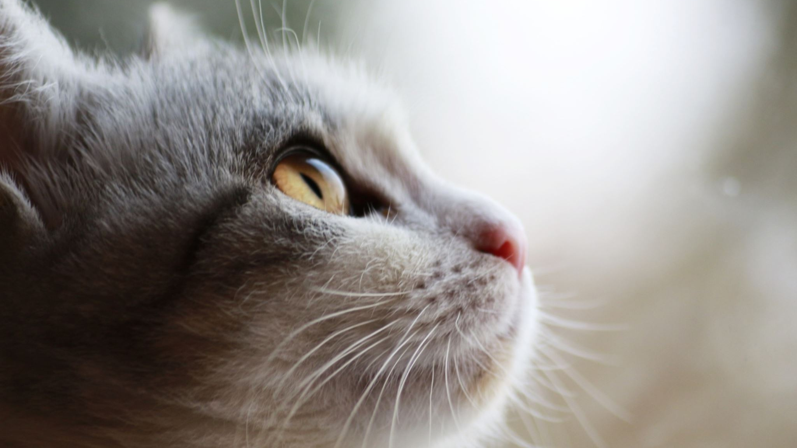
Reason 1
Cats are incredibly cute and fluffy. Looking at a cat can make anyone instantly happy! If you’re sad, hugging a cat will make your sorrows disappear.

Slide 4
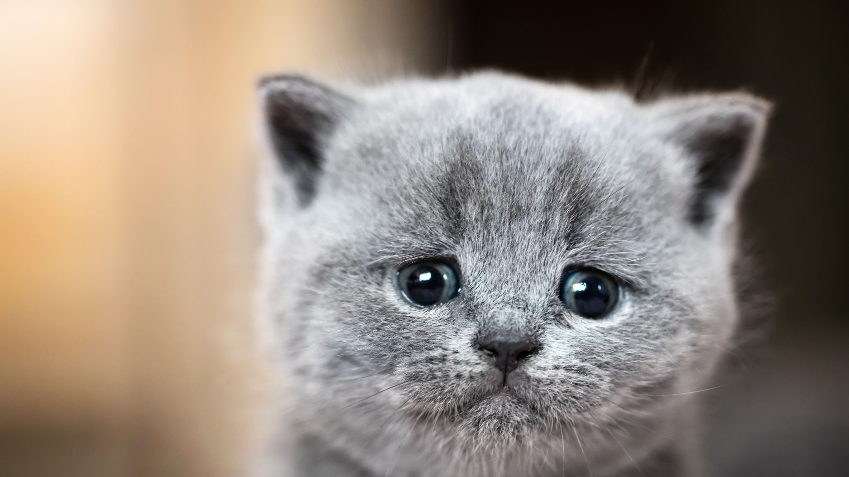
Reason 2
Cats have a long lifespan. Whenever you lose a household pet everyone in the family is devastated. It’s heartbreaking to lose a pet. Luckily, cats on average live 12 years, and some cats even live to be teenagers or even 20! Rest assured you won’t have to worry about your cat passing away for a long time.

Slide 5

Reason 3
Unlike other pets, cats are very low maintenance. All you need to do is give them food and water and they take care of the rest. They take themselves for walks, they clean up after themselves, and they don’t need any sort of training. Cats bring all the benefits of owning a pet, without the downsides of all the work it takes to take care of a pet.
Notes:
Have you ever had one of those days where you wake up and you feel too tired to do anything?

Slide 6
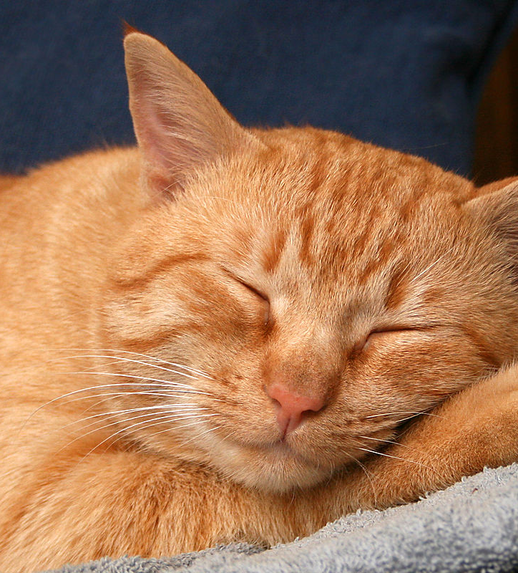
Conclusion
Cats are amazing! They’re cute, soft, fluffy, playful, make you happy, live long, and are very low maintenance. There’s very little to not like about a cat!

Slide 7
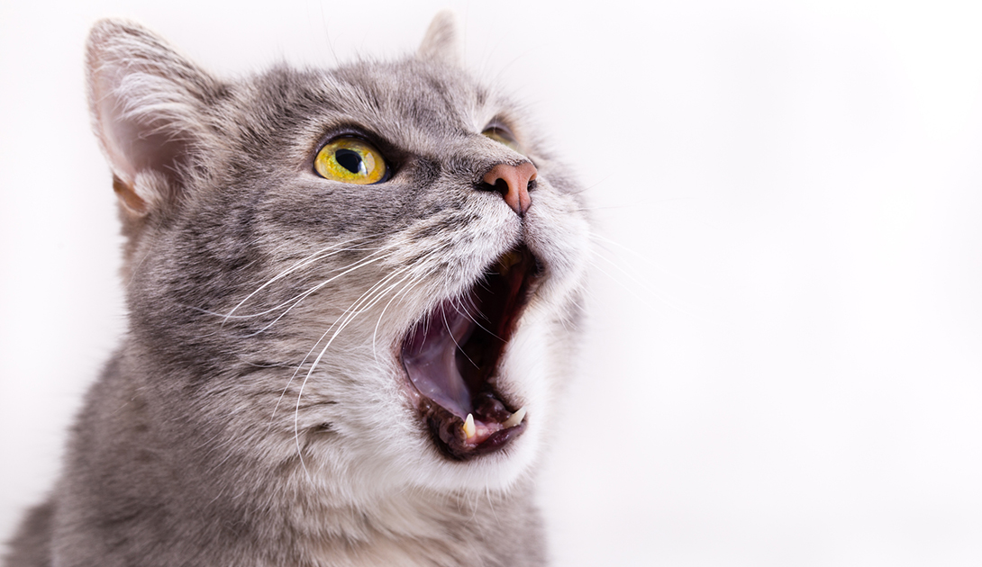
Thank you for listening! (Meow Meow)

